Slide 1
Voice Over Internet Protocol

Slide 2
Outline
Define VoIP
Protocols
Advantages / Disadvantages
Current Research

Slide 3
What is it?
VoIP allows you to make telephone calls using a computer network, over a data network like the Internet. VoIP converts the voice signal from your telephone into a digital signal that travels over the internet then converts it back at the other end so you can speak to anyone with a regular phone number. When placing a VoIP call using a phone with an adapter, you'll hear a dial tone and dial just as you always have. VoIP may also allow you to make a call directly from a computer using a conventional telephone or a microphone.
Also referred to as IP Telephony
Voice conversations are turned into digitized data and packetized for transmission across a network.

Slide 4
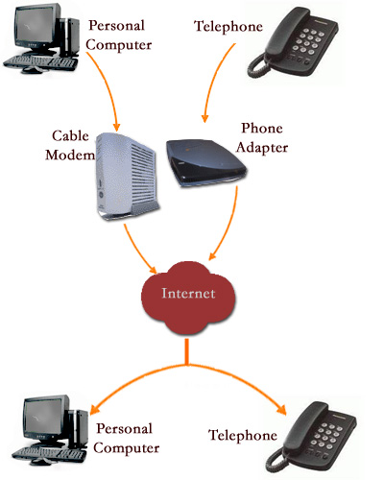
Picture

Slide 5
IP address to Phone Number
VoIP look for IP address
  Translate Phone numbers to IP addresses
The central call processor is a piece of hardware running a specialized database/mapping program called a soft switch.
Soft switches know:
  Where the endpoint is on the network
  What phone number is associated with that endpoint
  The current IP address assigned to that endpoint
If soft switch does not have the information, the request is handled by another soft switch.

Slide 6
Protocols
Used to connect different pieces of hardware.
H.323
  Most widely used protocol
  provides specifications for real-time, interactive videoconferencing, data sharing and audio applications (VoIP)
SIP
  More streamlined protocol
  Developed specifically for VoIP
Lack of a standard protocol is a problem. Not always compatible.

Slide 7
VoIP VS PSTN
PSTN = Public Switched Telephone Network
VoIP uses Packet Switching which is more efficient than a dedicated line
Also compression can be used
Can transmit data (video)

Slide 8
Advantages
Cost
  Free VoIP to VoIP
  Low cost VoIP to Public Switch Telephone Network (PSTN)
  Less bandwidth requirements
  Low cost / no cost software and hardware
Mobility
  Any internet connection
  Growing number of wireless broadband locations

Slide 9
Drawbacks
Quality
  High quality PSTN
  Variable VoIP dependent on connection
Dependent on wall power
Lost or delayed packets cause drop-out in voice
Emergency Calls
  Hard to find geographic location
Security
  Most VoIP services do not support encryption

Slide 10
Analysis of On-Off Patterns in VoIP and Their Effect on Voice Traffic Aggregation
Wenyu Jian and Henning Schulzrinne
  Department of Computer Science at Columbia University
Studied human speech which consists of talk-spurts and silence gaps (on-off paterns)
Benefits of silence suppression
  Allow higher bandwidth utilization
  Echo suppression
Found that spurt distributions is slightly more “heavy-tailed” than exponential

Slide 11
Assessment of VoIp Quality over Internet Backbones
Athina P. Markopoulou, Fouad A. Tobagi, Mansour J. Karam
Assess quality of VoIp
Cosidered
  Delay and loss
  Voice quality
  Playback buffer schemes

Slide 12
Results
Many paths performed poorly for VoIP traffic due to long delays and large delay variability
Playback buffer schemes – tradeoff between data loss and increased delay in the buffer
Overall rated VoIP as poor
Mark voice traffic and give it preferential treatment
Choose playback buffer scheme to match delay pattern

